Slide 1
Introduction to R Markdown
18.01.2023
Julius Fenn, M.Sc.

Slide 2

What is R Markdown?

Slide 3
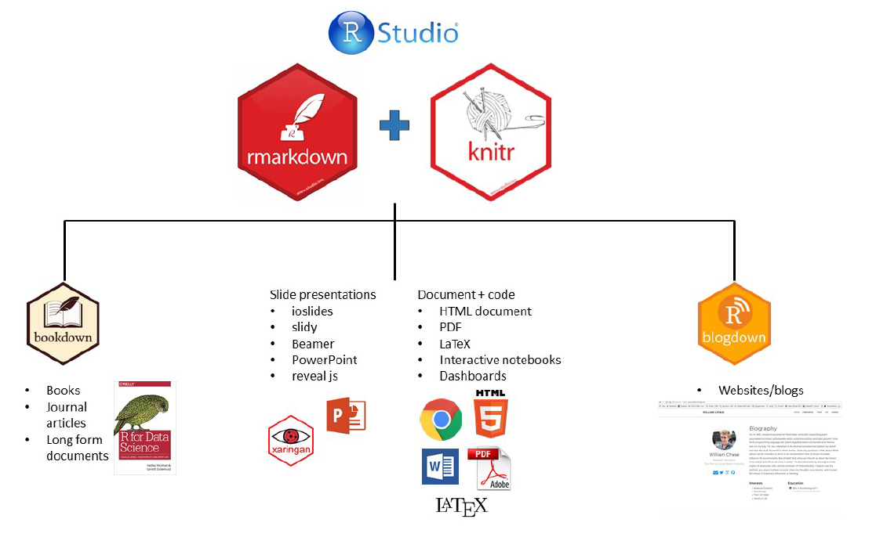
R Markdown

Slide 4
Examples
Bookdown: https://rmarkdown.rstudio.com/docs/
Bookdown: https://r4ds.had.co.nz/
Shiny-App / dashboard (interactive): https://jjallaire.shinyapps.io/shiny-kmeans/
Own work:
Shiny-App: https://fennapps.shinyapps.io/shinyCAMELv01/
Website: https://fennstatistics.netlify.app/

Slide 5
R Markdown
R Markdown allows you to create documents that serve as a neat record of your analysis
enables reproducible research (appendix to a paper, upload it to an online repository, keep as a personal record, ...)
RMarkdown file (.Rmd), when you knit the RMarkdown file, the Markdown formatting and the R code are evaluated, and an output file (HTML, PDF, etc) is produced.
R Markdown makes use of Markdown syntax
R Markdown converted to standard Markdown using ‘knitr’ package

Slide 6
What is markdown?
Markdown is a very simple ‘markup’ language (=HTML)
provides methods for creating documents with headers, images, links etc. from plain text files, while
keeping the original plain text file easy to read
Basic Syntax:
https://www.markdownguide.org/basic-syntax
https://raw.githubusercontent.com/rstudio/cheatsheets/main/rmarkdown.pdf

Slide 7
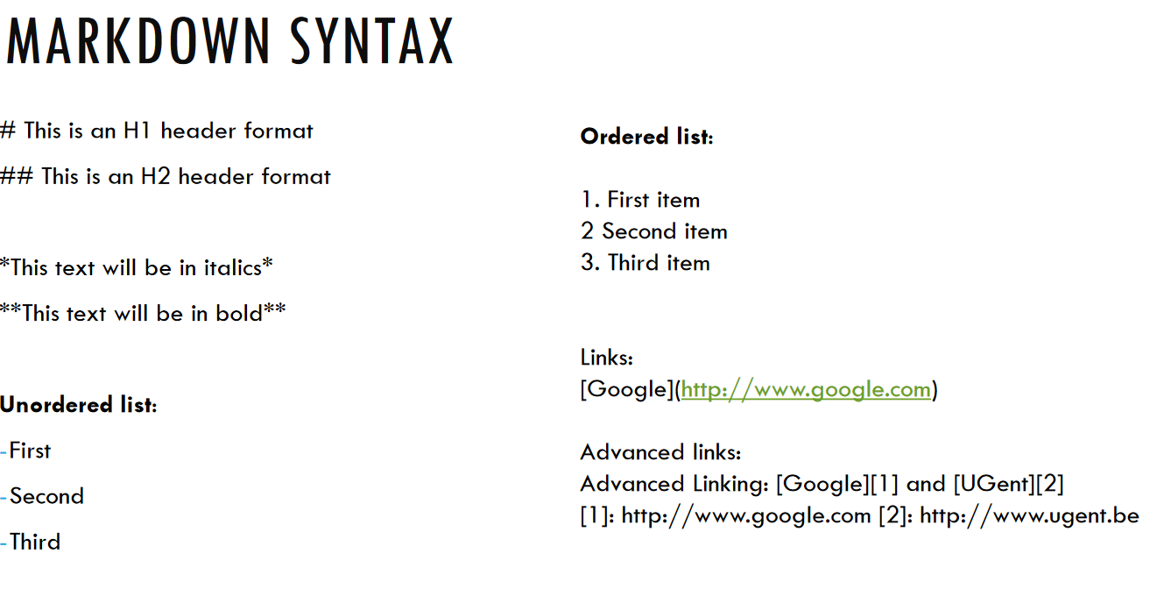
Markdown syntax

Slide 8
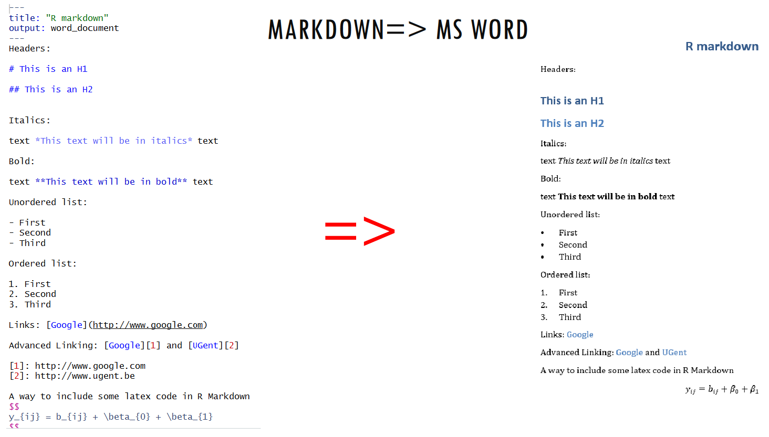
Mardown to MS Word

Slide 9
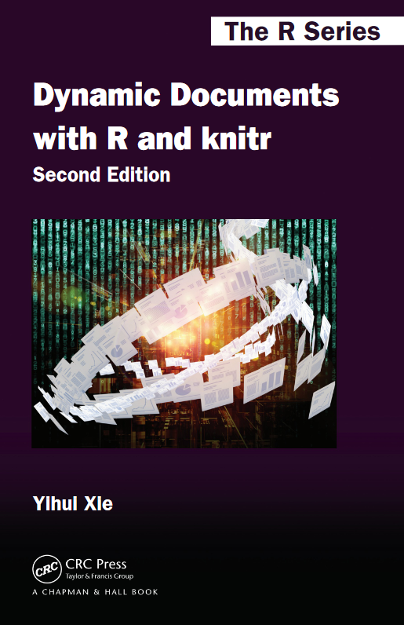
What is knitr?
R package designed for dynamic report generation in R
Script contains a mixture of text and R code, which is when processed replaced by text and output, including figures and tables
Uses R as programming language and a documentation language (LateX, Markdown)
Inline R code within the text and separate code chunks
Xie, Y. (2017). Dynamic Documents with R and knitr. Chapman and Hall/CRC, download: https://duhi23.github.io/Analisis-de-datos/Yihue.pdf

Slide 10
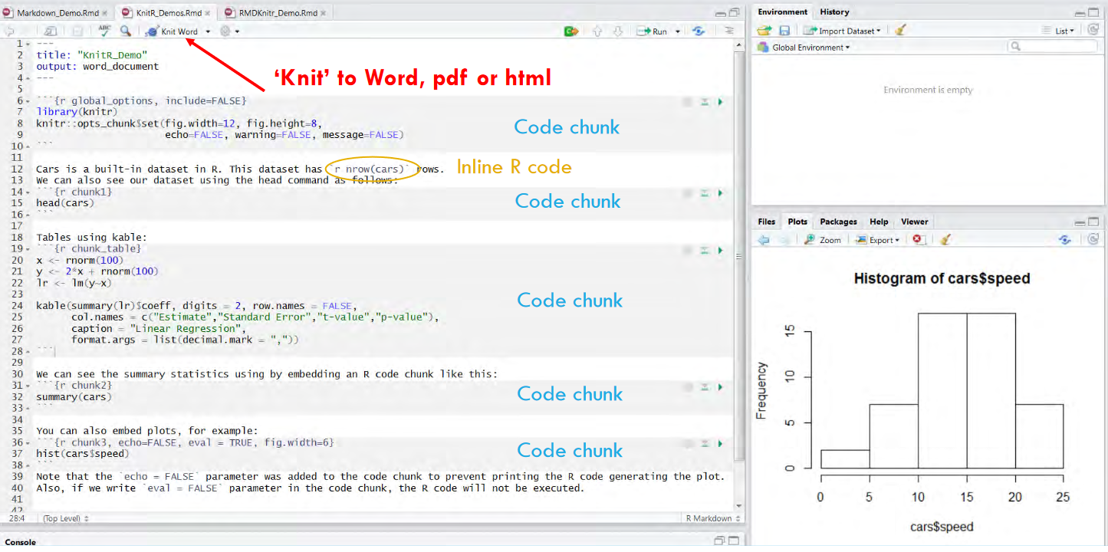
Using rmarkdown (knitr) in R Studio

Slide 11
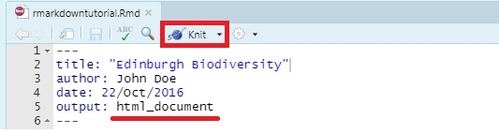
Elements: YAML Header
at the top of any RMarkdown script is a YAML header section enclosed by ---
by default this includes a title, author, date and the file type you want to output to
many other options are available for different functions and formatting

Slide 12
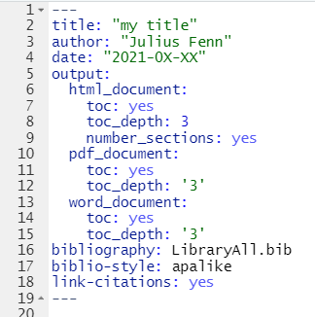
Elements: YAML Header
using the toc option and specify the depth of headers that it applies to using the toc_depth option
us to specify a bibliography file using the bibliography metadata field in YAML
See: https://bookdown.org/yihui/rmarkdown-cookbook/bibliography.html

Slide 13
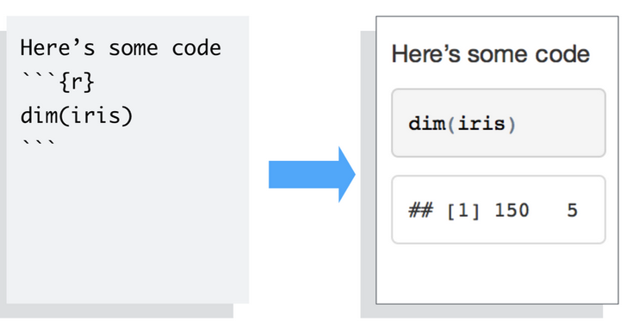
Elements: Code chunk
To embed a chunk of R code into your report, surround the code with two lines that each contain three backticks. After the first set of backticks, include {r}, which alerts knitr that you have included a chunk of R code

Slide 14
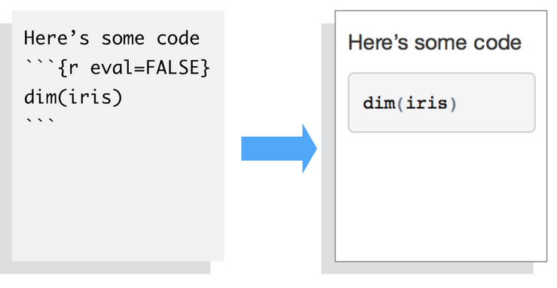
Elements: Code chunk options
to omit the results from your final report (and not run the code) add the argument eval = FALSE inside the brackets and after r

Slide 15
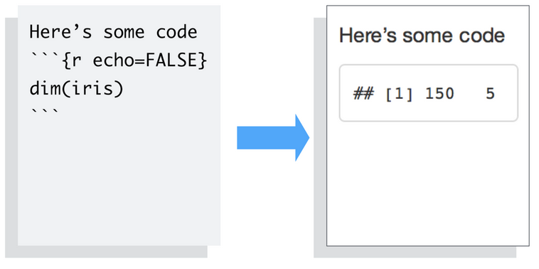
Elements: Code chunk options
to omit the code from the final report (while including the results) add the argument echo = FALSE

Slide 16
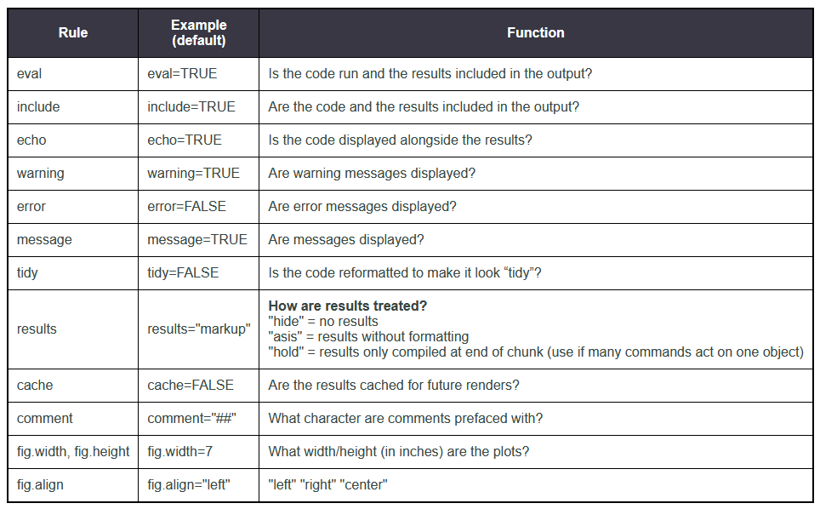
More Code Chunk Instructions
all possible options see: https://yihui.org/knitr/options/

Slide 17
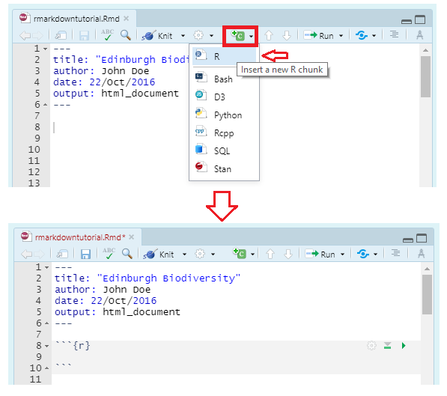
Elements: Code chunk insert

Slide 18
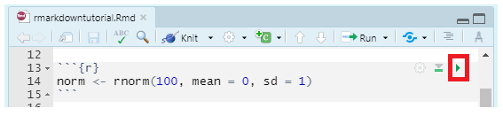
Elements: Code chunk run
you can run an individual chunk of code at any time by clicking on the small green arrow and the output of the code will appear just beneath the code chunk

Slide 19
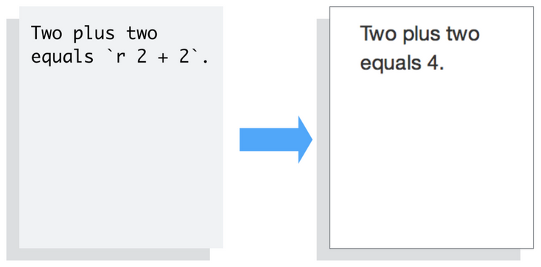
Elements: Inline code
knitr will replace the inline code with its result in your final document (inline code is always replaced by its result). The result will appear as if it were part of the original text

Slide 20
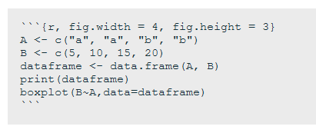
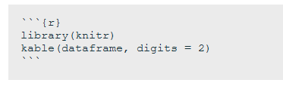
Inserting figures, tables
by default, RMarkdown will place graphs by maximizing their height, while keeping them within the margins of the page and maintaining aspect ratio
the most aesthetically pleasing and simple table formatting function is kable() in the knitr package (and stargazer package)

Slide 21
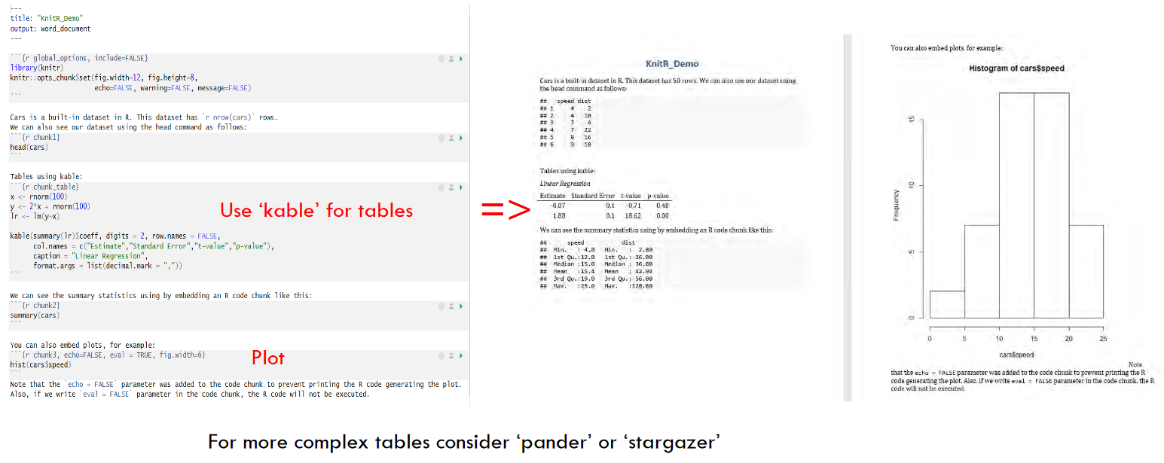
R CODE + TEXT => REPORT

Slide 22
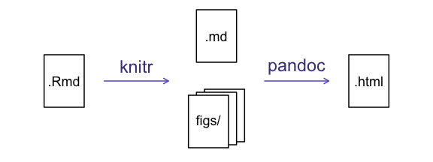
Relationship between R Markdown, Knitr and Pandoc
Pandoc is a document converter. It can convert from a number of different markup formats to many other formats, such as .doc, .pdf etc.
R Markdown is based on markdown: a lightweight markup language with plain text formatting syntax designed so that it can be converted to HTML and many other formats
! no clearly defined Markdown standard
rmarkdown is a library which proceses and converts .Rmd files into a number of different formats
In detail see: https://stackoverflow.com/questions/40563479/relationship-between-r-markdown-knitr-pandoc-and-bookdown

